Slide 1
MySQL + Hibernate
Alicja Salamon, Dawid Aksamit

Slide 2
O MySQL
był pisany raczej z myślą o szybkości niż kompatybilności ze standardem SQL
Popularny wsród webowych aplikacji – część szeroko rozpowszechnionego LAMP - złożonego open sourcowych: Linux, Apache, MySQL, Perl/PHP/Python
Free-software-open source projects that require a full-featured database management system often use MySQL.Ciekawe cechy, zalety, wady, przeznaczenie -> w wersji 5 dodano procedury składowane, wyzwalacze , widoki
the world's most widely used

Slide 3
O MySQL - wady
Like other SQL databases, MySQL does not currently comply with the full SQL standard for some of the implemented functionality, including foreign key references when using some storage engines other than the 'standard' InnoDB.
Triggers are currently limited to one per action / timing, i.e. maximum one after insert and one before insert on the same table. There are no triggers on views.
MySQL, like most other transactional relational databases, is strongly limited by hard disk performance. This is especially true in terms of write latency.

Slide 4
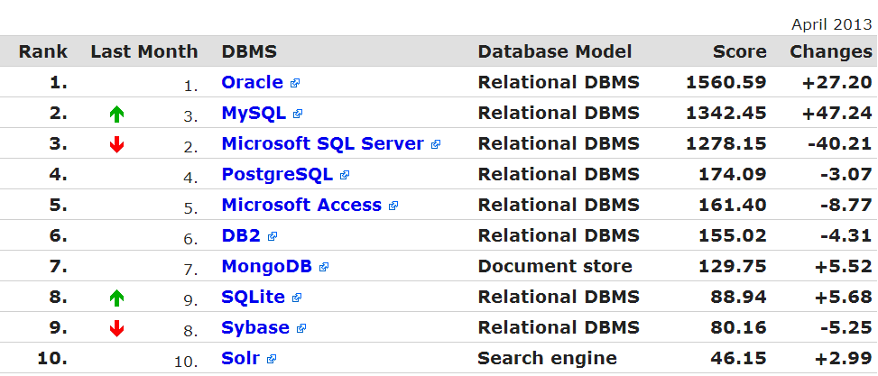
http://db-engines.com/en/ranking
MySQL is also used in many high-profile, large-scale World Wide Web products, including
Wikipedia
Google (though not for searches),
Facebook
Twitter,
YouTube

Slide 5
O Hibernate
Założenia i cele twórców
Ciekawe cechy, zalety, wady, przeznaczenie

Slide 6
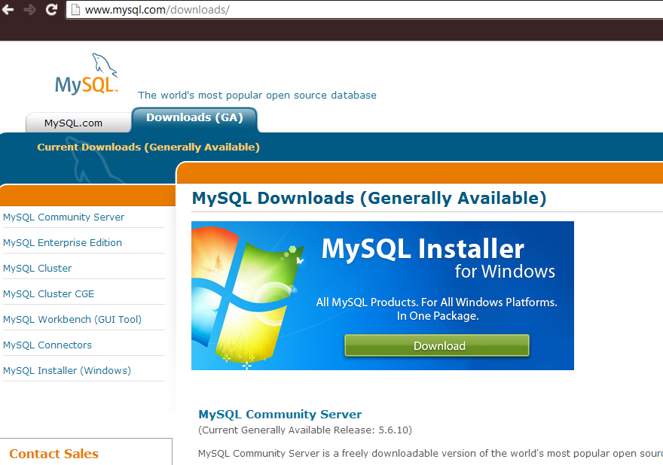
1. Instalacja MySQL

Slide 7
Instalacja
Tu cos od Dawida bedzie

Slide 8
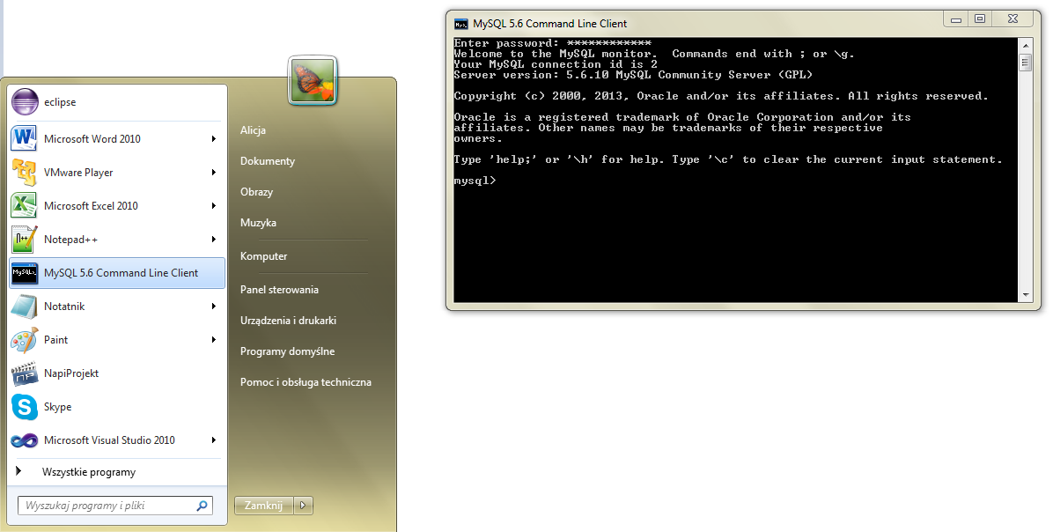
2a. Uruchomienie – command line

Slide 9
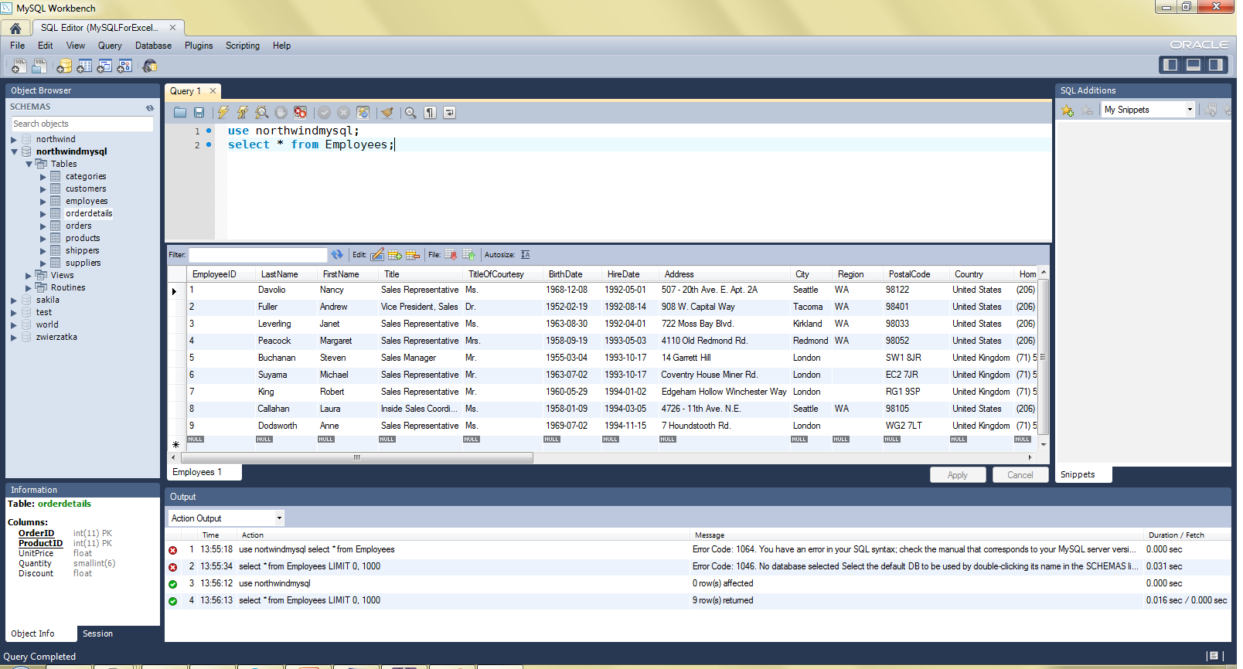
2b. Uruchomienie - Workbench

Slide 10
Tworzenie bazy danych
mysql> CREATE DATABASE northwind;
Query OK, 1 row affected (0.16 sec)
mysql> drop DATABASE nortwind;
Query OK, 0 rows affected (1.28 sec)
mysql> show databases;
+--------------------+
| Database |
+--------------------+
| information_schema |
| mysql |
| northwind |
| test |
| world |
+--------------------+
mysql> USE northwind
Database changed
mysql> show tables;
+--------------------------+
| Tables_in_northwind |
+--------------------------+
| categories |
| customers |
| employees |
| orderdetails |
| orders |
| products |
| shippers |
| suppliers |
+--------------------------+

Slide 11
Tworzenie tabeli
CREATE TABLE Products( ProductID INT NOT NULL AUTO_INCREMENT, ProductName VARCHAR(40) NOT NULL, SupplierID INT NOT NULL, CategoryID INT NOT NULL, QuantityPerUnit VARCHAR(20), UnitPrice FLOAT DEFAULT 0, UnitsInStock SMALLINT DEFAULT 0, UnitsOnOrder SMALLINT DEFAULT 0, ReorderLevel SMALLINT DEFAULT 0, Discontinued TINYINT DEFAULT 0 NOT NULL, FOREIGN KEY (CategoryID) REFERENCES Categories (CategoryID), FOREIGN KEY (SupplierID) REFERENCES Suppliers (SupplierID), PRIMARY KEY (ProductID), INDEX ProductName (ProductName)
)ENGINE=InnoDB;

Slide 12
Opis tabeli
mysql> describe Products;
+-----------------+---------------+------+-----+---------+----------------+
| Field | Type | Null | Key | Default | Extra |
+-----------------+---------------+------+-----+---------+----------------+
| ProductID | int(11) | NO | PRI | NULL | auto_increment |
| ProductName | varchar(40) | NO | | NULL | |
| SupplierID | int(11) | NO | MUL | NULL | |
| CategoryID | int(11) | NO | MUL | NULL | |
| ContactName | varchar(30) | NO | | NULL | |
| QuantityPerUnit | varchar(20) | NO | | NULL | |
| UnitPrice | decimal(10,2) | NO | | NULL | |
| UnitsInStock | smallint(6) | NO | | NULL | |
| UnitsOnOrder | smallint(6) | NO | | NULL | |
| ReorderLevel | smallint(6) | YES | | NULL | |
| Discounted | bit(1) | NO | | NULL | |
+-----------------+---------------+------+-----+---------+----------------+

Slide 13
Wstawianie danych
INSERT INTO `categories`
(`CategoryID`, `CategoryName`, `Description`, `Picture`) VALUES
(1, 'Beverages', 'Soft drinks, beers, and ales', NULL),
(2, 'Condiments', 'Sweet and savory sauces', ''),
(3, 'Confections', 'Desserts, candies, and sweet breads', ''),
(4, 'Dairy Products', 'Cheeses', ''),
(5, 'Grains/Cereals', 'Breads, crackers, pasta, and cereal', ''),
(6, 'Meat/Poultry', 'Prepared meats', ''),
(7, 'Produce', 'Dried fruit and bean curd', ''),
(8, 'Seafood', 'Seaweed and fish', '');
LOAD DATA LOCAL INFILE '/path/data.txt' INTO TABLE Categories LINES TERMINATED BY '\r\n';

Slide 14
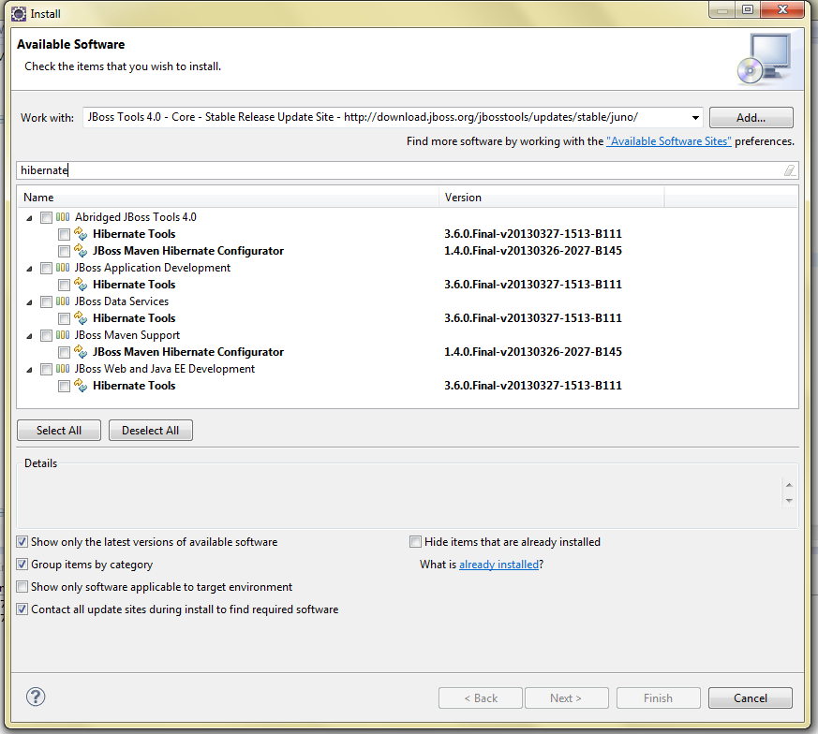
Wtyczka do Eclipsa
http://download.jboss.org/jbosstools/updates/stable/juno/

Slide 15
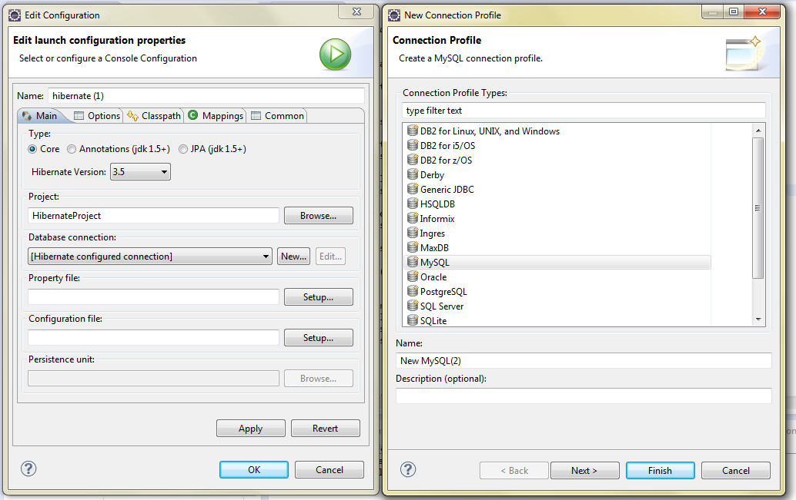
Nowe połączenie

Slide 16
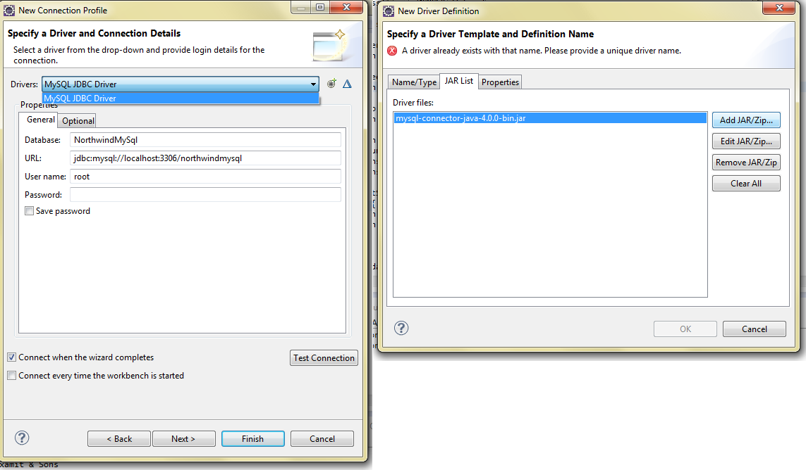
Sterownik
http://www.mysql.com/downloads/connector/j/

Slide 17
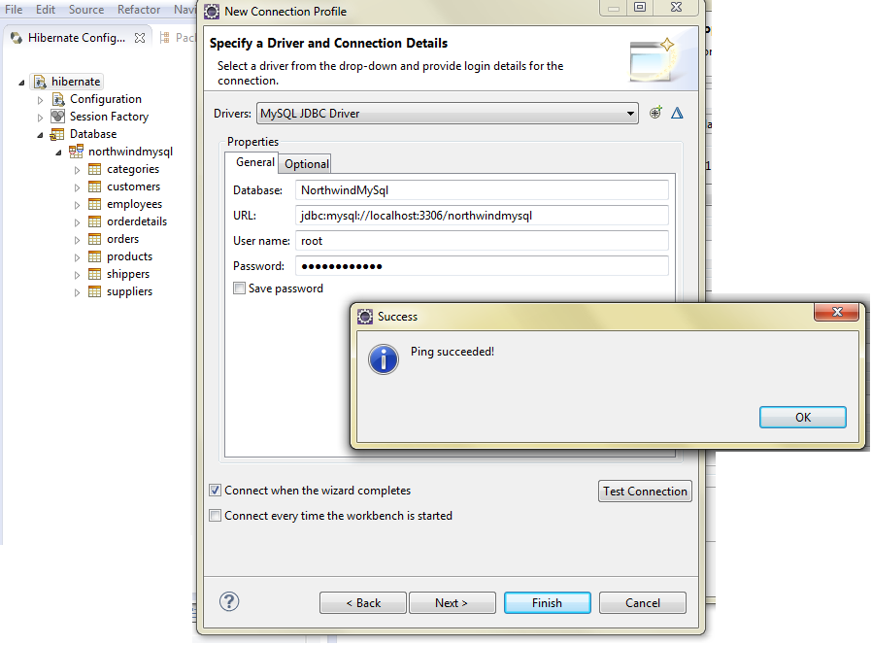
Ping

Slide 18
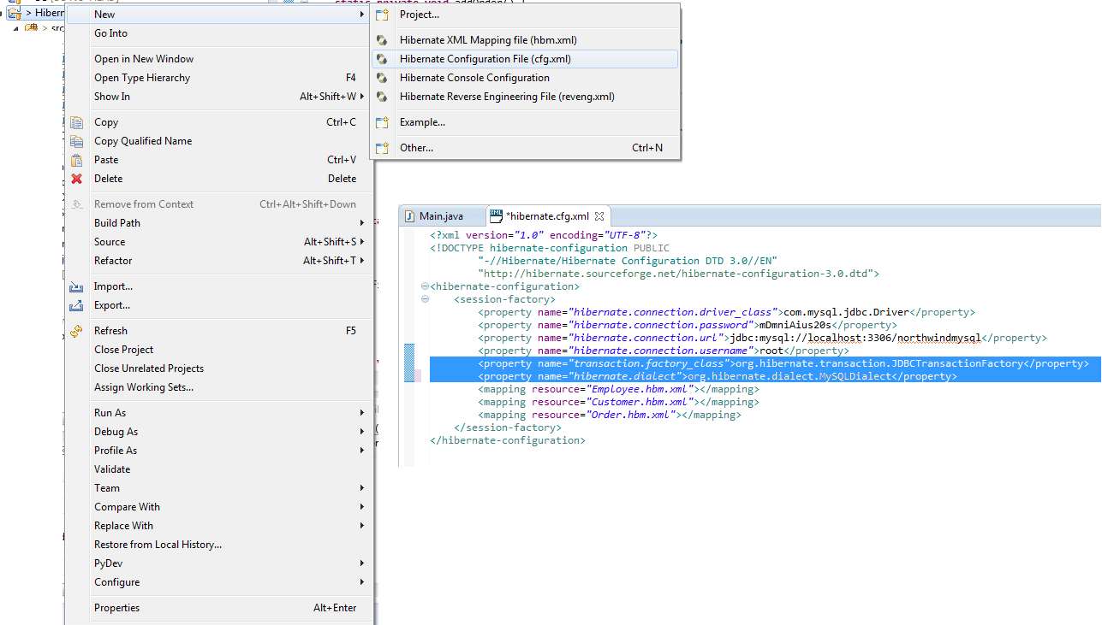
hibernate.cfg.xml

Slide 19
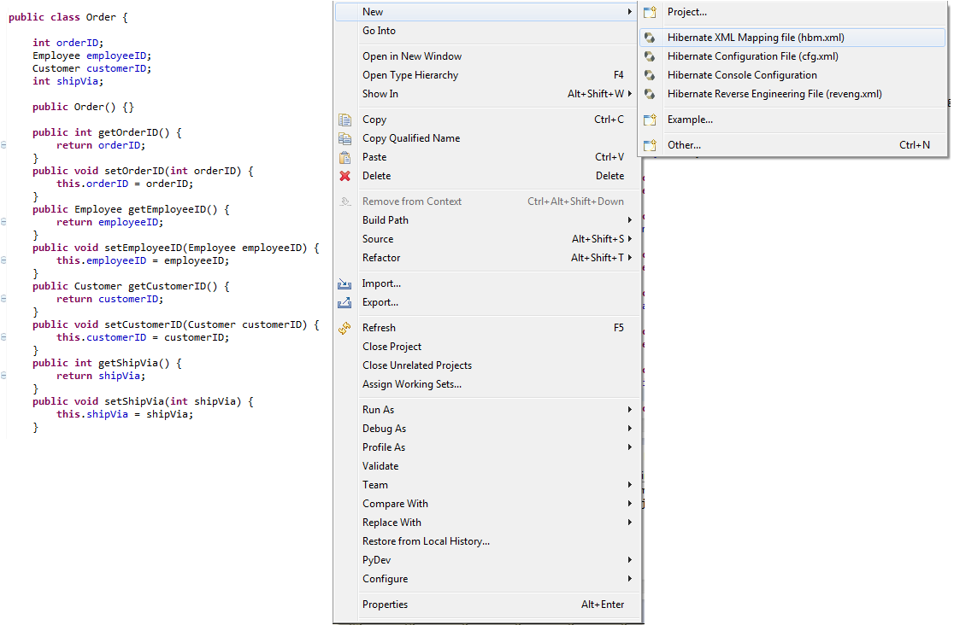
POJO + mapping file

Slide 20
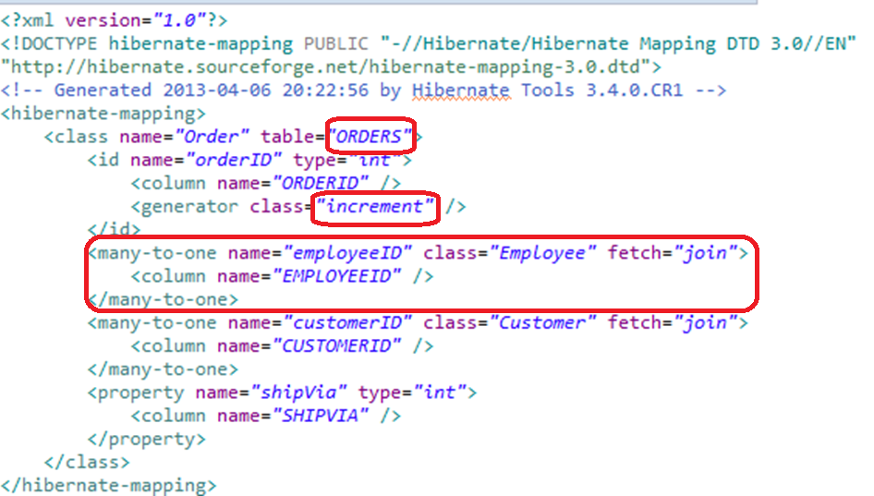
Order.hbm.xml

Slide 21
Session Factory
private static SessionFactory sessionFactory;
private static ServiceRegistry serviceRegistry;
private static SessionFactory buildSessionFactory() {
try {
// Create the SessionFactory from hibernate.cfg.xml
Configuration configuration = new Configuration().configure();
serviceRegistry = new ServiceRegistryBuilder().applySettings(
configuration.getProperties()).buildServiceRegistry();
sessionFactory = configuration.buildSessionFactory(serviceRegistry);
return sessionFactory;
} catch (HibernateException he) {
throw new ExceptionInInitializerError(he);
}
}

Slide 22
Transakcje
Transaction trns = null;
Session session = HibernateUtil.getSessionFactory().openSession();
try {
trns = session.beginTransaction();
//...
session.getTransaction().commit();
} catch (RuntimeException e) {
if (trns != null)
trns.rollback();
e.printStackTrace();
} finally {
session.flush();
session.close();
}

Slide 23
Create…
Customer c = new Customer("AXAMI", "Aksamit INC.");
session.save(c);
Employee e = new Employee("Alicja", "Salamon", "Krakow");
session.save(e);
Order o = new Order(e, c);
session.save(o);

Slide 24
Read…
List<Order> ordersList = newSession
.createSQLQuery("select * from Orders where OrderID=11078")
.addEntity(Order.class).list();
for (Iterator<Order> iter = ordersList.iterator(); iter.hasNext();) {
Order order = (Order) iter.next();
Employee empl = order.getEmployeeID();
Customer cust = order.getCustomerID();
System.out.println(order.getOrderID() + " by "
+ empl.getFirstName() + " " + empl.getLastName() + " for "
+ cust.getCompanyName());
}

Slide 25
Update…
Customer c = new Customer();
c.customerID = „SCINC";
c.companyName = „SomeCompany INC";
session.update(c);
Employee e = new Employee(„Jones", „John", „Warsaw");
e.EmployeeID=10;
session.update(e);

Slide 26
Delete…
Order o = new Order();
o.setOrderID(11078);
session.delete(o);
Customer c1 = new Customer();
c1.setCustomerID(„SCINC");
session.delete(c1);
Employee e = new Employee();
e.EmployeeID = 10;
session.delete(e);

Slide 27
Źródła

